Slide 1
Acknowledgement Internet Images, available in Public Domain, have been used in many Slides of this Presentation. Some of the Images have also been Modified/Superimposed. Used only for Academic Purpose/Understanding.
Lecture-7
Takeaways :
Field Experiments for Determining Time Constants of Systems & Equipment
Understanding System Type (from Transfer Functions) and Steady State Errors
Concept of Frequency Response & Introduction to Bode Plots
Understanding Bode Magnitude Plots for Obtaining Corner Frequencies of Dynamical Systems
Relating Rise Time & Bandwidth for Appropriate Sensor Selection based on Process Dynamics
Discretization for Digital Control --- Introduction to the Concept of z-transforms

Slide 2
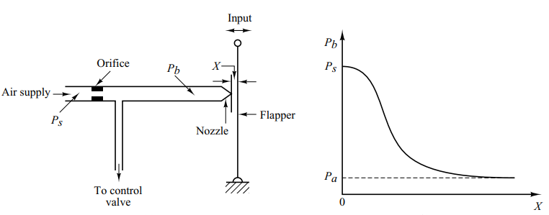
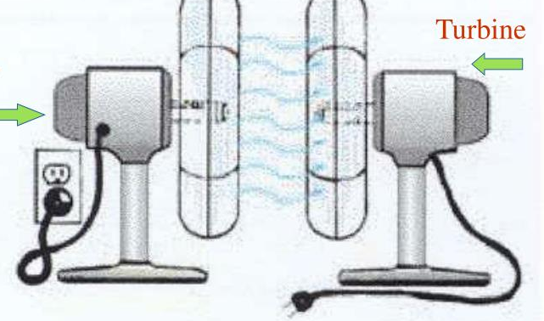
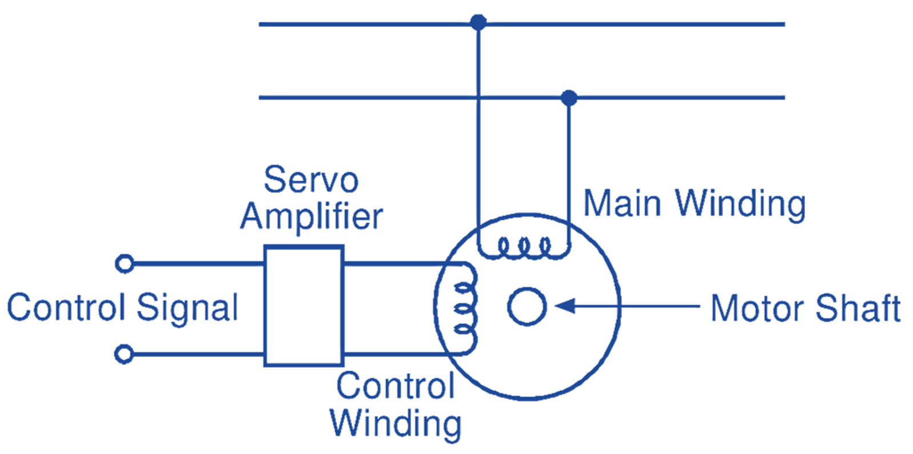
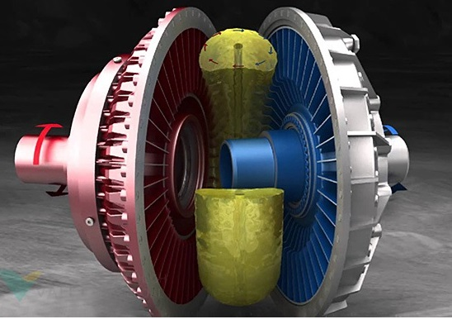
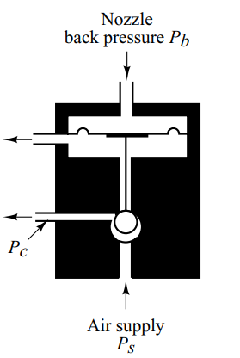
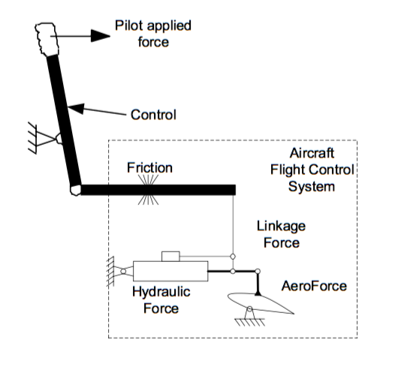
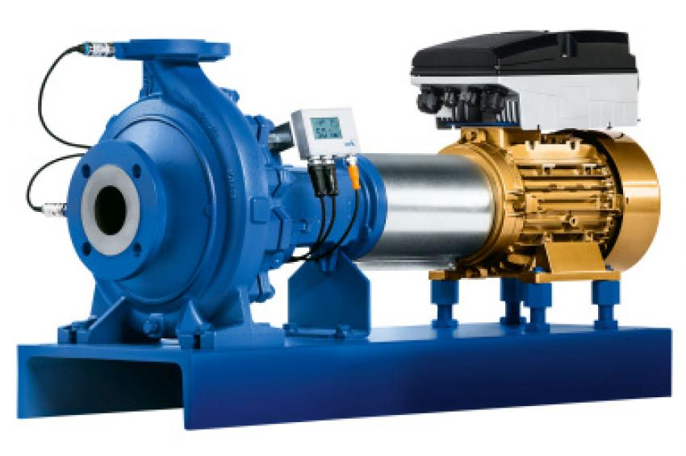
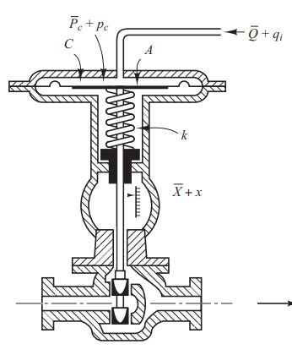
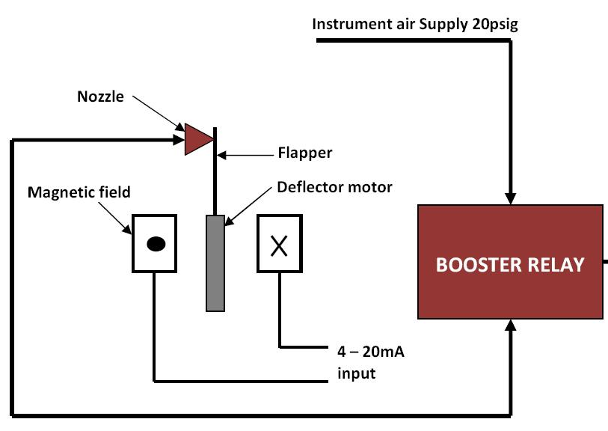
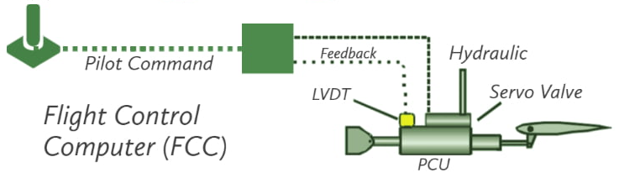
Pneumatic, Mechanical, Hydraulic, Electrical, Controllers

Slide 3
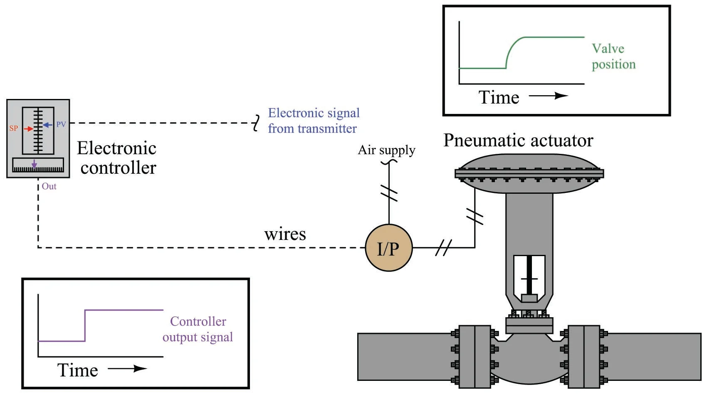
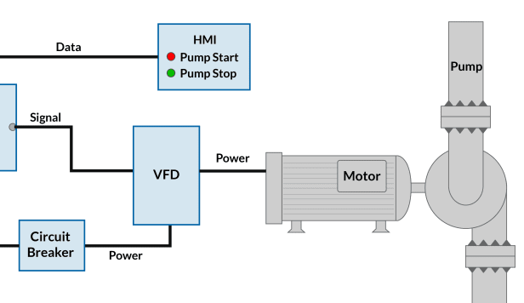
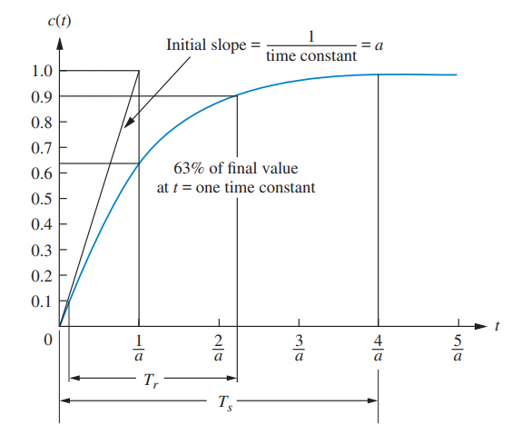
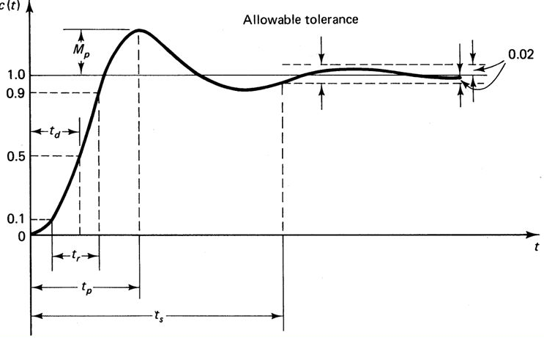
Determining the Time Constant of Field Equipment --- Monitoring of Drifts/ Degradation

Slide 4

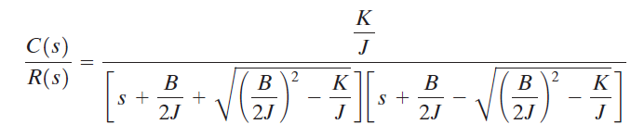
Understanding Parametric Changes, from Response Characteristics
Delay time, t_{d}: The delay time is the time required for the response to reach half the final value the very first time.
Rise time, t_{r} : The rise time is the time required for the response to rise from 10% to 90%, 5% to 95%, or 0% to 100% of its final value. For underdamped second order systems, the 0% to 100% rise time is normally used. For overdamped systems, the 10% to 90% rise time is commonly used.
Peak time, t_{p}: The peak time is the time required for the response to reach the first peak of the overshoot.
Maximum (percent) overshoot, M_{p}: The maximum overshoot is the maximum peak value of the response curve measured from unity. If the final steady-state value of the response differs from unity, then it is common to use the maximum percent overshoot. It is defined by The amount of the maximum (percent) overshoot directly indicates the relative stability of the system.
Settling time, t_{s} : The settling time is the time required for the response curve to reach and stay within a range about the final value of size specified by absolute percentage of the final value (usually 2% or 5%). The settling time is related to the largest time constant of the control system
Delay time
Rise time
3. Peak time
4. Maximum overshoot
5. Settling time

Slide 5
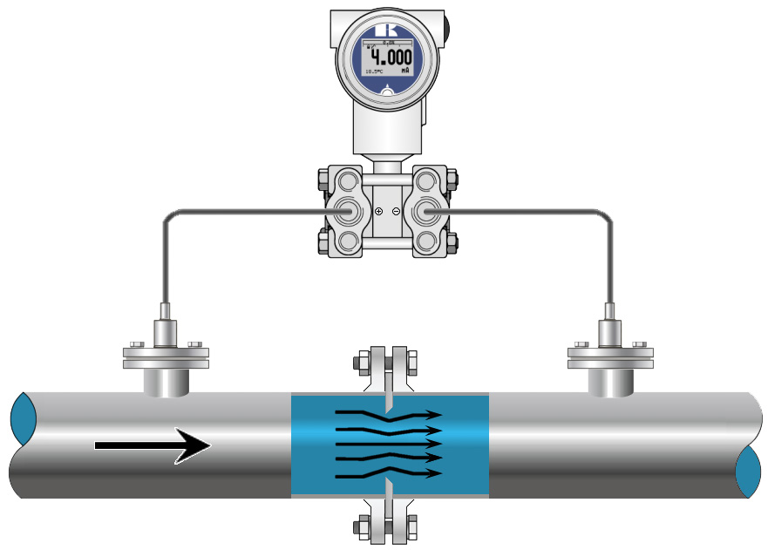
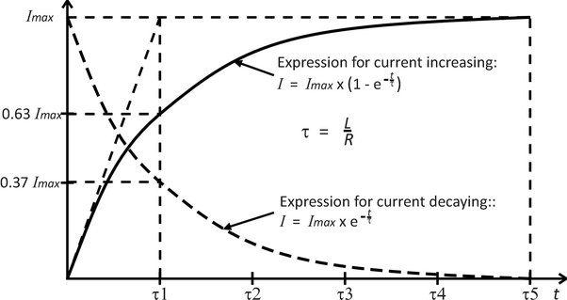
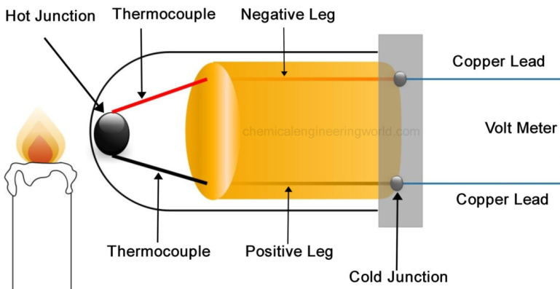
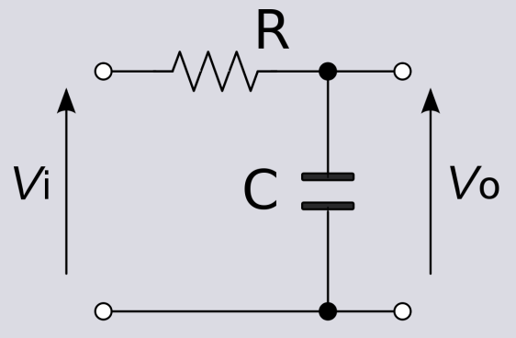
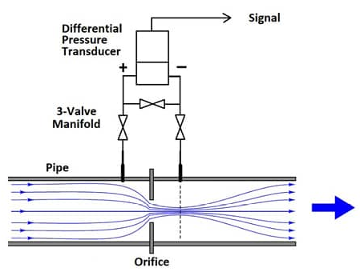
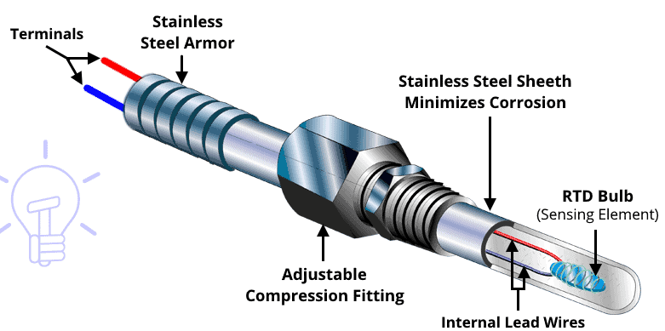
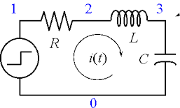
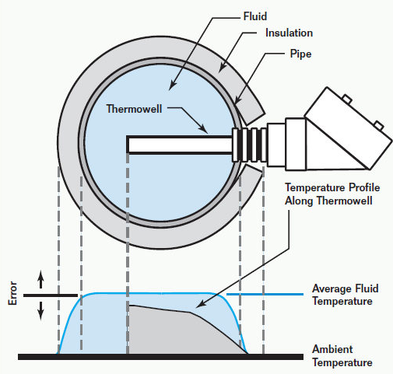
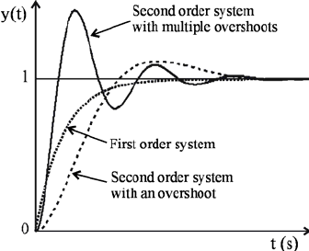
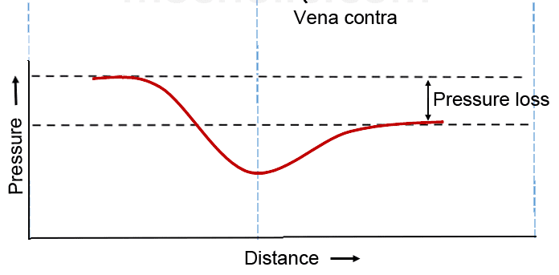
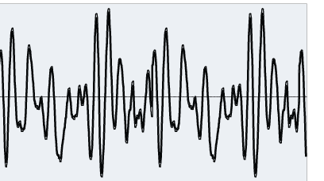
Determining Time Constants of Sensors

Slide 6
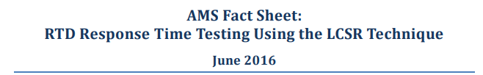
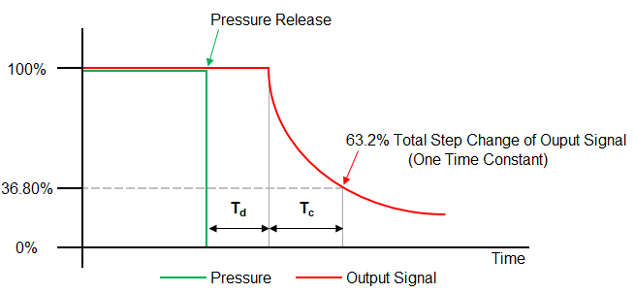
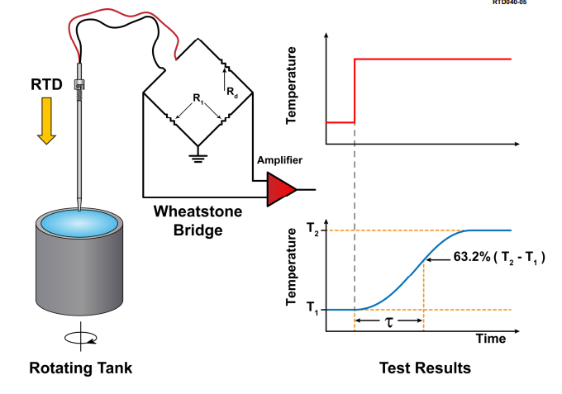
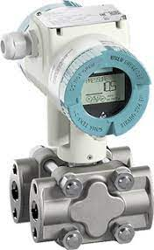
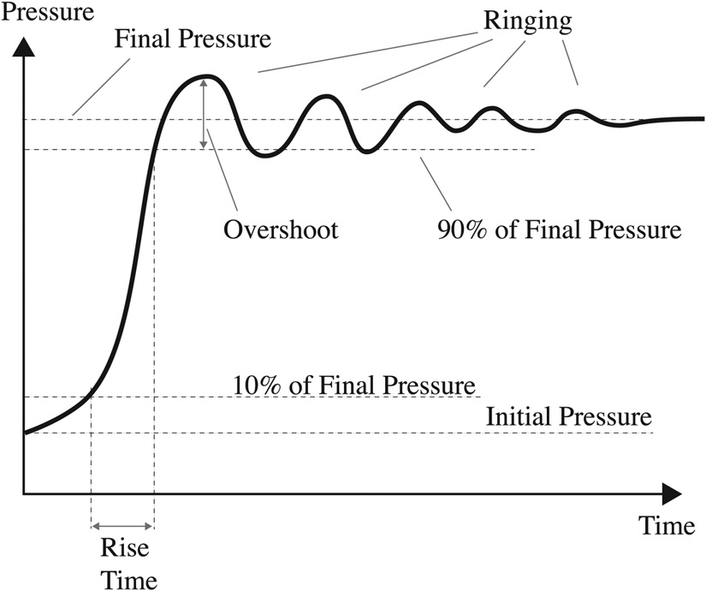
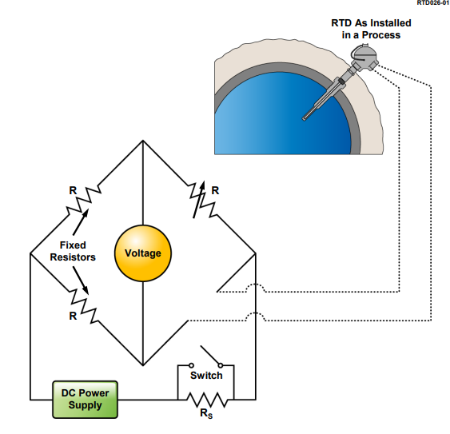
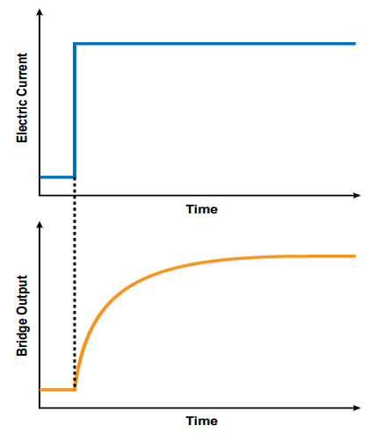
Acknowledgment

Slide 7
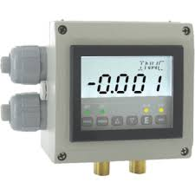
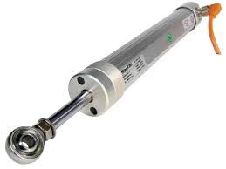
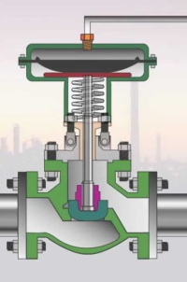
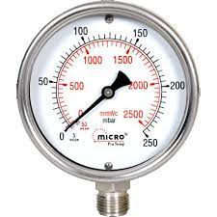
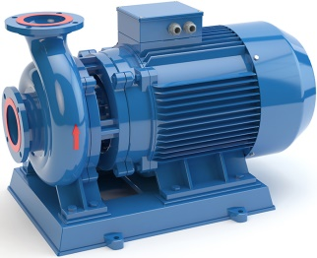
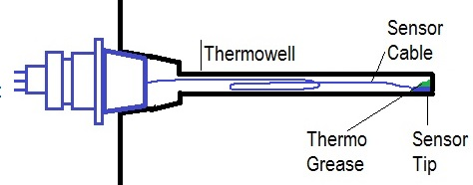
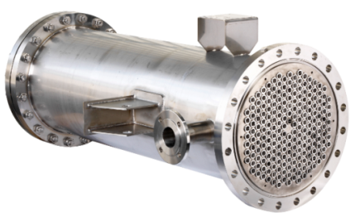
Pressure Measurement
Loop Performance Monitoring
Pneumatic Signal
Header
Control Valves
Heat Source
Surge Tank
Discharge
Suction
Pumps
Characterizing Segments of Loop
Heat Exchangers
Secy. Flow
Primary Flow

Slide 8
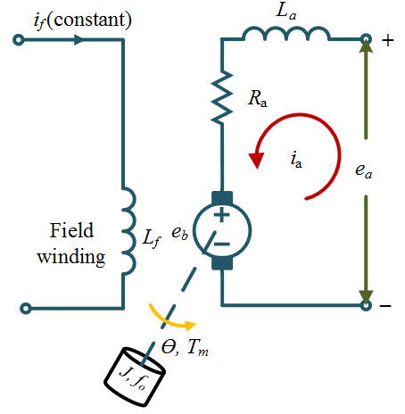
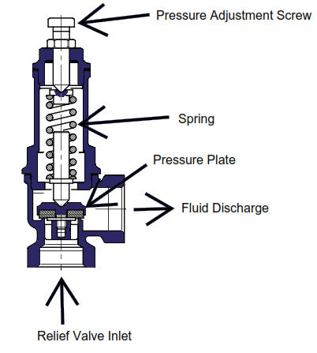
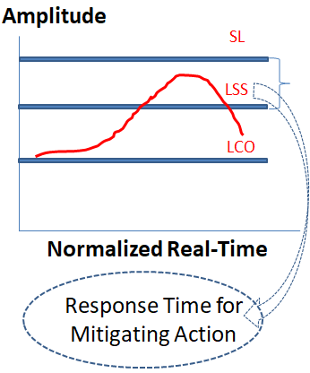
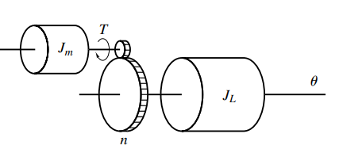

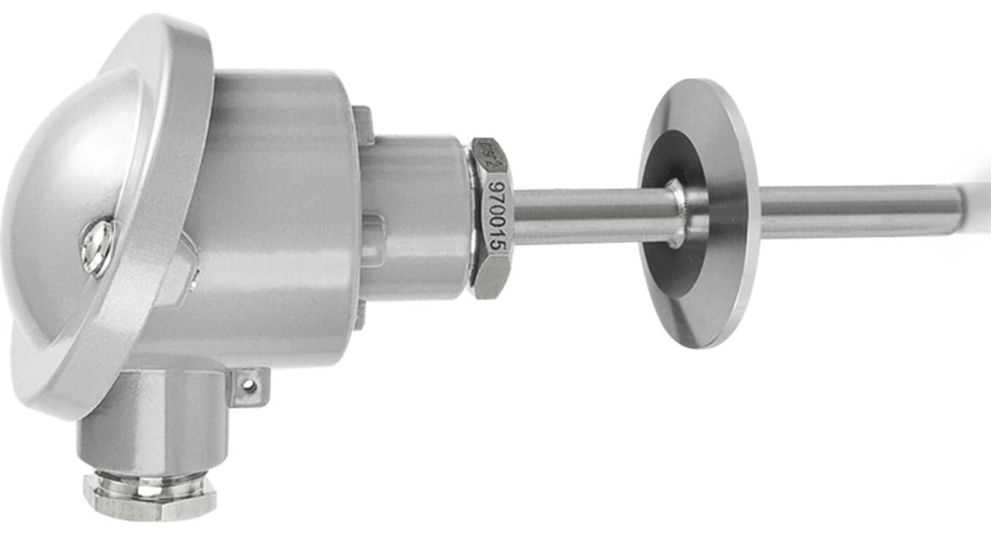
Response of Sensors & Actuators for Safety Action
Cold Water I/P
Boiler

Slide 9
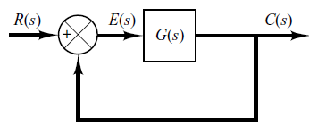
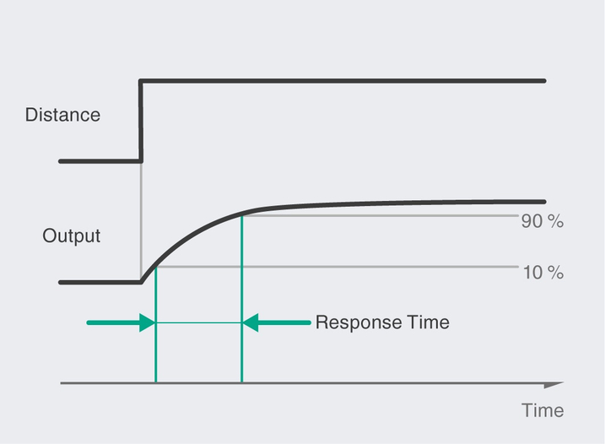

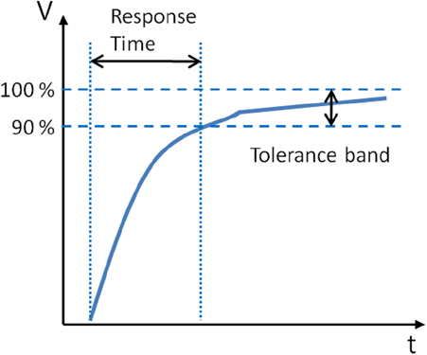
The Concept of Steady State Error

Slide 10

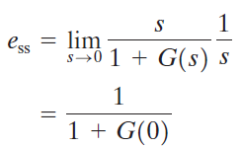
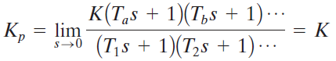



Steady State Error

